Slide 1


CH3 – Crypto challenge
TEAM #1

Slide 2

(1) %68%61%69%72 (ASCII coding)
a (%61) b (%62) c (%63) d (%64) e (%65) f (%66) g (%67) h (%68) i (%69)
j (%6A) k (%6B) l (%6C) m (%6D) n (%6E) o (%6F) p (%70) q (%71) r (%72)
s (%73) t (%74) u (%75) v (%76) w (%77) x (%78) y (%79) z (%80) SPACE (%20)
%68 = h
%61 = a
%69 = i
%72 = r

Slide 3
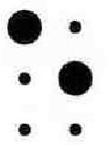
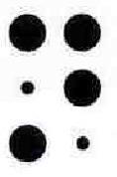
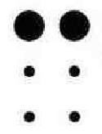
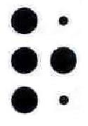
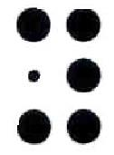
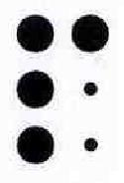
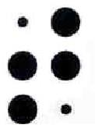
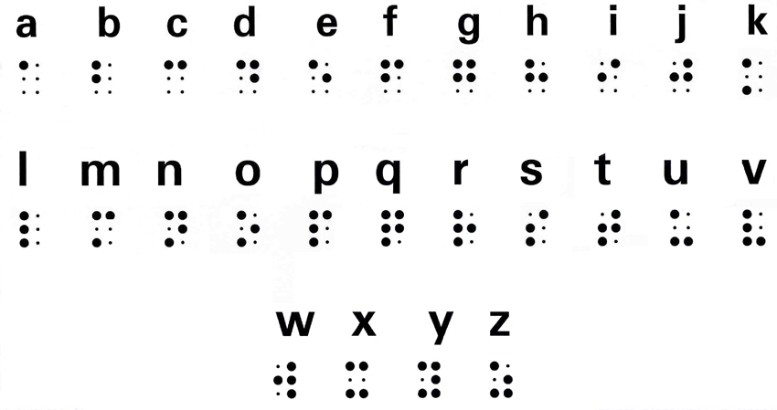
(2) Braille cipher:
E n c r y p t

Slide 4
(3) The gold bug cipher: *‡(]5:
The mapping is:
Example:
5 - A
3‡‡† - good
305)) - glass
6* - in
;48 - the
a | b | c | d | e | f | g | h | i | j | k | l | m | n | o | p | q | r | s | t | u | v | w | x | y | z
5 | 2 | - | † | 8 | 1 | 3 | 4 | 6 | , | 7 | 0 | 9 | * | ‡ | . | $ | ( | ) | ; | ? | ¶ | ] | ¢ | : | [
The answer is:
n | o | r | w | a | y
* | ‡ | ( | ] | 5 | :

Slide 5
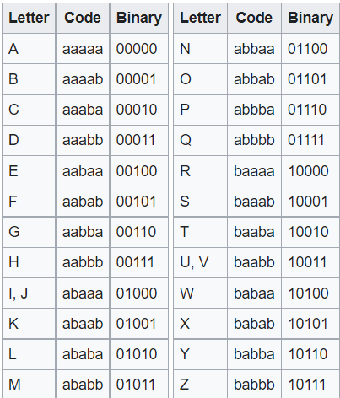
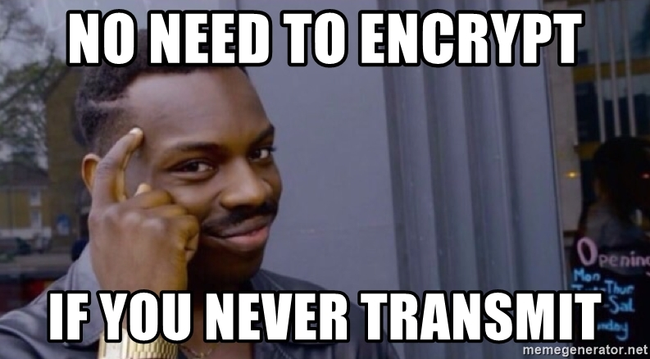
(4) Bacon cipher: BAAAB AABBB AABAA ABABA AABAB
The answer is:
BAAAB | AABBB | AABAA | ABABA | AABAB
S | H | E | L | F

Slide 6
(5) Dvorak cipher: IPAOO
a | b | c | d | e | f | g | h | i | j | k | l | m | n | o | p | q | r | s | t | u | v | w | x | y | z
a | x | j | e | . | u | i | d | c | h | t | n | m | b | r | l | ' | p | o | y | g | k | , | q | f | ;
Plain:
Cipher:
The answer is:
I | P | A | O | O
G | R | A | S | S

Slide 7
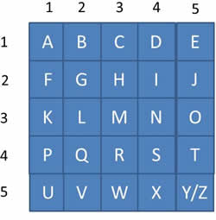
(6) Tap cipher: . .. .. .... ... ..... ... ... . ..... .... ..... .... ... .. .... . ...
[row][column]:
[.][..] = B
[..][....] = I
[...][.....] = O
[...][...] = M
[.][.....] = E Biometric
[....][.....] = T
[....][...] = R
[..][....] = I
[.][...] = C

Slide 8
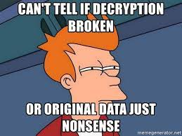
(7) Caesar cipher: RJCUG
After trying all the three options, we found that the two shifts bring a real answer:
The answer is:
for two shifts:
Plain: abcdefghijklmnopqrstuvwxyz
Cipher: CDEFGHIJKLMNOPQRSTUVWXYZAB
Shift | R | J | C | U | G
1 | Q | I | N | T | F
2 | P | H | A | S | E
3 | O | G | Z | R | D

Slide 9
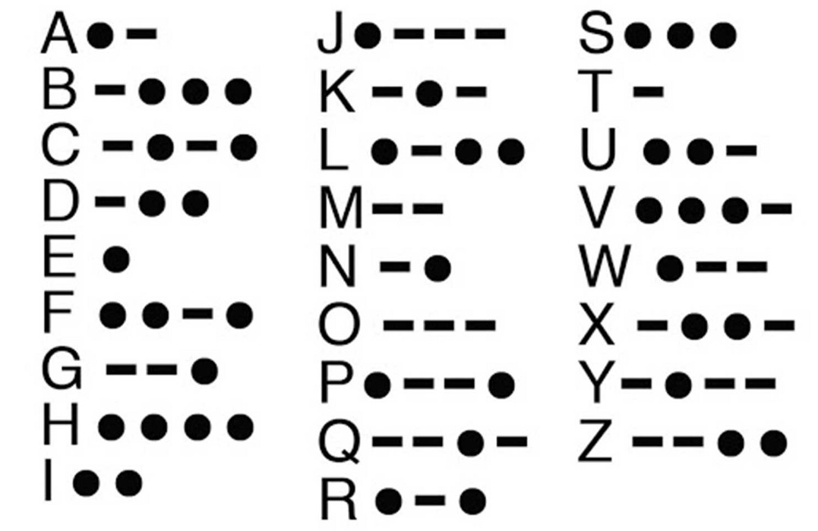
(8) Morse code: (···) (·— —·) (·) (·—) (·—·)
(···) | (·— —·) | (·) | (·—) | (·—·)
S | P | E | A | R

Slide 10
(9) Diffie-Hellman method: G=337, N=1399, x=5, y=4
Bob and Alice agree publicly on a prime modulus (N) and a generator (G).
Bob picks a private random value of x and Alice picks a private random value of y.
b = G^{x} mod N
a = G^{y} mod N
Bob sends the value of b publicly to Alice, and Alice sends the value of a publicly to Bob.
Key = a^{x} mod N
Key = b^{y} mod N
The key value is 1,267
b = 337⁵ mod 1399 = 555
a = 337⁴ mod 1399 = 944
Key = 944⁵ mod 1399 = 1267
Key = 555⁴ mod 1399 = 1267

Slide 11
(10) EX-OR cipher: Word: simulator, Key: slippy
Simulator | 01110011 | 01101001 | 01101101 | 01110101 | 01101100 | 01100001 | 01110100 | 01101111 | 01110010
Slippy | 01110011 | 01101100 | 01101001 | 01110000 | 01110000 | 01111001
EX-OR | 00000000 | 00000101 | 00000100 | 00000101 | 00011100 | 00011000
HEX | 0 0 | 0 5 | 0 4 | 0 5 | 1 c | 1 8
The answer is:
0 0 0 5 0 4 0 5 1 c 1 8

Slide 12
(11) RSA
e: 65537
N: 696026718829707141234015255193382147
Cipher: 6255639640170097520001174621866023
Find p and q by using alpertron.com.ar/ECM.HTM
p = 670302131471996423
q = 1038377600413143589
Calculate T = (p-1)*(q-1) = 696026718829707139525335523308242136
Find d using the equation (e*d) mod T = 1
(65537*d) mod 696026718829707139525335523308242136 = 1
d = 627132425147538132489602249894741873
Calculate cipher^{d} mod N
6255639640170097520001174621866023^627132425147538132489602249894741873
mod 696026718829707141234015255193382147 = 1403

Slide 13


